Slide 1


DESIGN 1
Lesson 4: Build Sprint 2: Images and a Table
Ms. Abboud • Grade 9 - Design 1 • Term 1, Week 10

Slide 2
Learning Objectives
WALT - We Are Learning To
WILF - What I'm Looking For
Add images with meaningful alt text and a table of real data.
My images display and have meaningful alt text.
My table has a header row and real data.

Slide 3
Frayer Model: Alt Text (Review)
DEFINITION
CHARACTERISTICS
The alt attribute's description of an image, used by screen readers and shown if the image fails to load.
An attribute on <img>; describes the image in words; read by screen readers.
ALT TEXT
EXAMPLES
NON-EXAMPLES
alt="An Arabian oryx standing in the desert".
The raw file name as the description, e.g. "IMG_2024.jpg".

Slide 4
National Identity Integration
UAE Smart Government: UAE government websites are planned around the people who use them. Today you plan your own website for a specific audience, the same way.

Slide 5
STARTER
Which Alt Text Is Better?
alt="image" or alt="An Arabian oryx standing in the desert"
Who relies on alt text?
Hook • Engage & Ask
5 - 10 minutes

Slide 6
LESSON CORE
I Do: Images and Tables Recap
Save images in your images folder first.
A table needs a header row (th) and real data (td).
Gradual Release of Responsibility
30 - 40 minutes
Example: an image and a small table
<img src="images/oryx.jpg" alt="An Arabian oryx" width="300">
<table>
<tr><th>Animal</th><th>Size</th></tr>
<tr><td>Oryx</td><td>1 m tall</td></tr>
</table>
1 / 3

Slide 7
LESSON CORE
We Do: Build Milestone Check
Optional 10 pts: specification 3, pages and menu 4, content started 3.
Your teacher checks each site while everyone keeps building.
Gradual Release of Responsibility
30 - 40 minutes
2 / 3

Slide 8
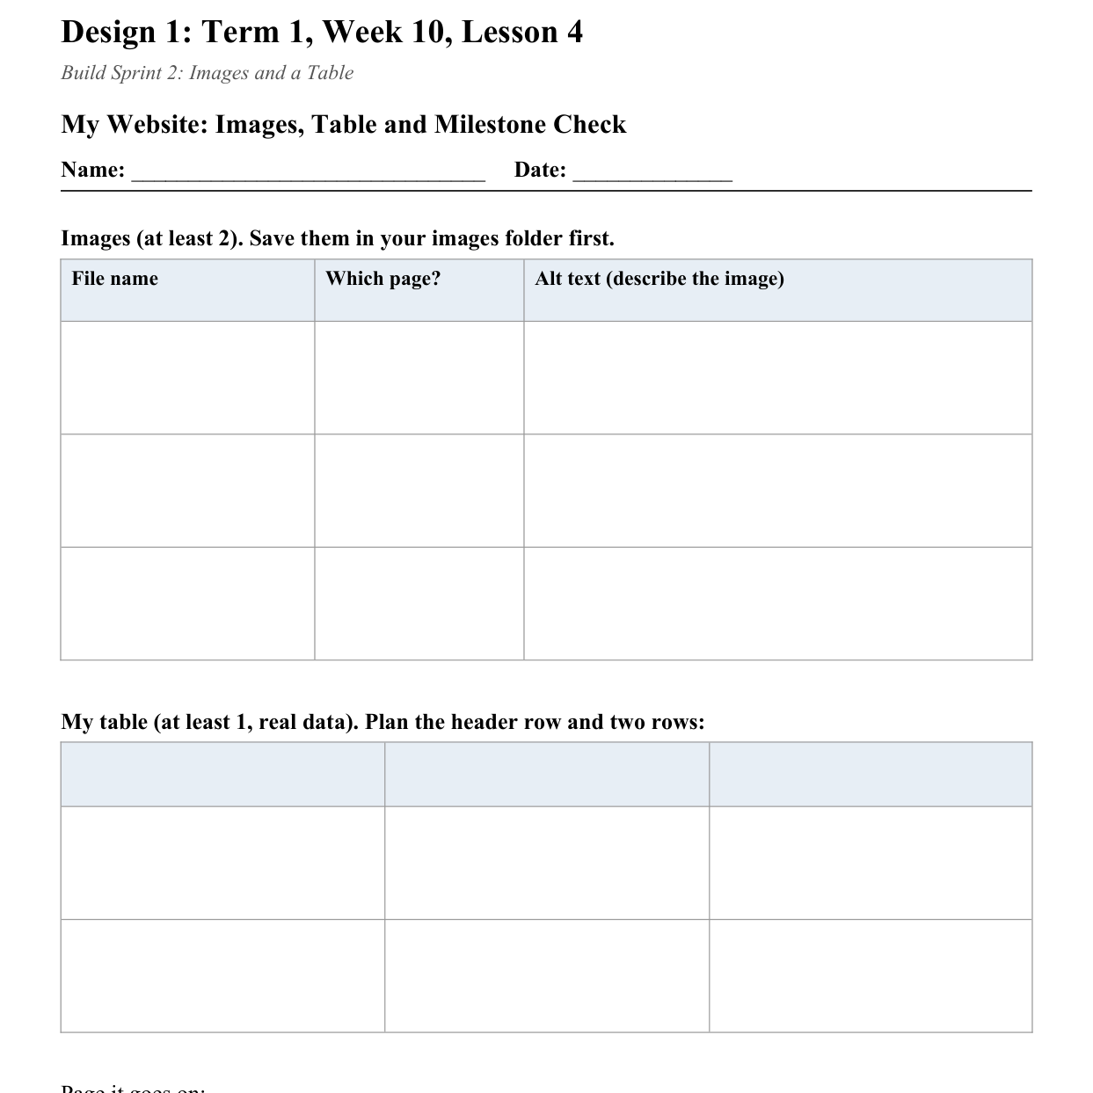
LESSON CORE
You Do: Add Images and a Table
Add at least 2 images with alt text and 1 table of real data.
Then finish any page that is still empty.
Activity: Images and Table
Gradual Release of Responsibility
30 - 40 minutes
3 / 3

Slide 9
CLOSURE
Exit Ticket
What is the biggest thing still missing from your site?
Transition & Extend
5 - 10 minutes

